Slide 1
Automatic dV/dQ analysis and map of Neware data (Fixed upper cutoff DOD cells at 40°C)
Roby Gauthier, Jeff Dahn

Slide 2
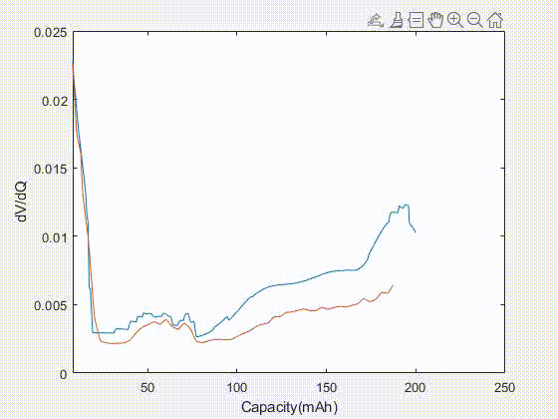
dV/dQ scanning on one cycle
The program do a scanning of all possible slippage and active electrode masses within a finite matrix.
Since we have 4 four parameter (+ slippage, - slippage, + mass, - mass), this correspond to a 4D matrix.
Here is a example of a 2D matrix scanning (the negative electrode parameters are fixed).
This is cycle 500 of cell ID 66824.
As seen in the gif, sometimes a part of the experimental data at large capacity is removed. This is due to the way the vector is build from interpolation. This will not impact the χ² values later.

Slide 3
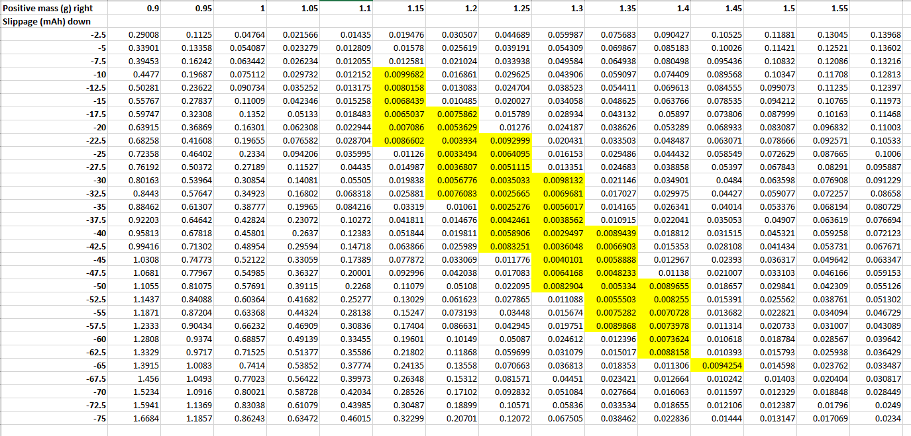
χ² results for a simple 2D matrix (sum between 20 and 170 mAh)

Slide 4
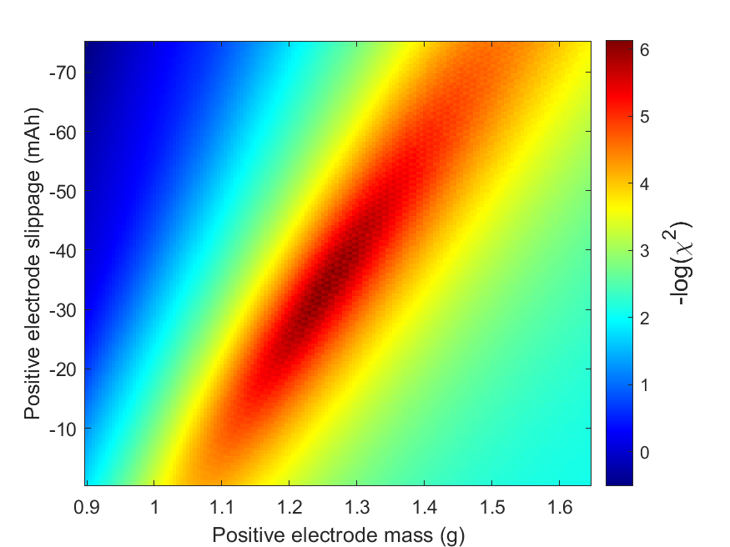
The same cell ID and cycle number, but a 300 by 300 matrix.

Slide 5
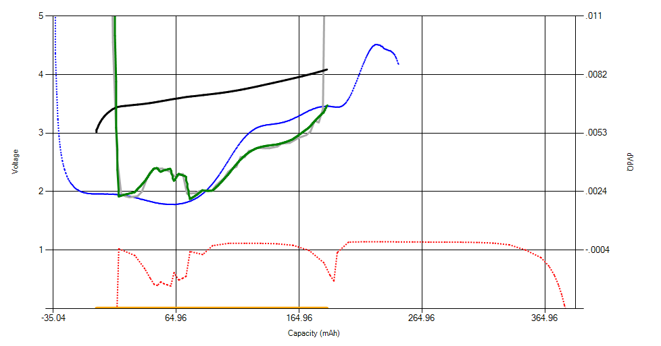
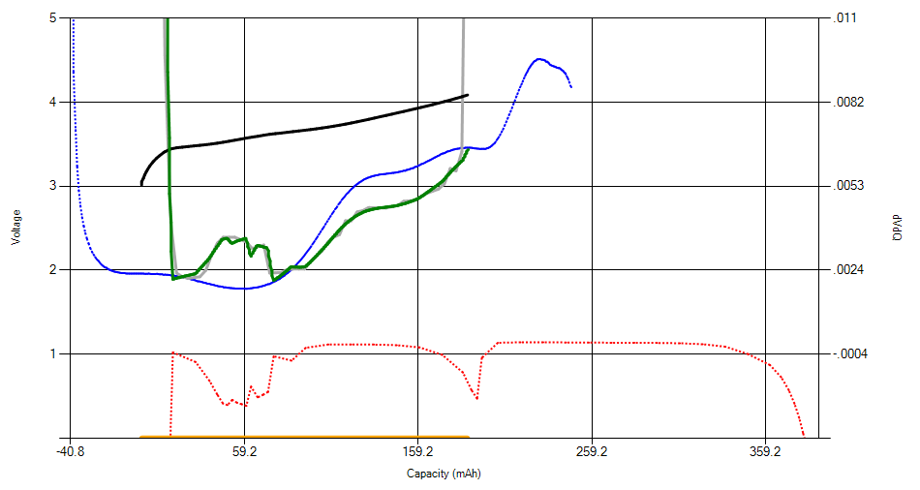
Matlab program vs by hand
It took 0.4 seconds to get this results using the Matlab program.
Results can improve with more precision, but take more computational time.
Matlab program best:
-> m+ = 1.25 g
-> Slipp+ = -35 mAh
(Negative parameters fixed):
-> m- = 1.04 g
-> Slipp- = -3 mAh
By hand best:
-> m+ = 1.282 g
-> Slipp+ = -40.8 mAh
(Negative parameters fixed):
-> m- = 1.04 g
-> Slipp- = -3.2 mAh

Slide 6
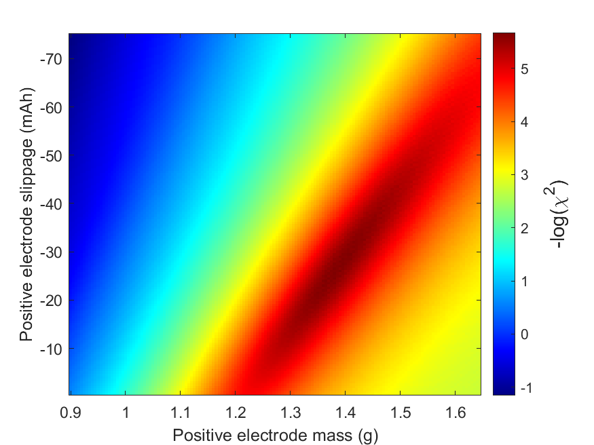
Matlab program fitting vs VAWQuum program fitting
66824 - Cycle 1
VAWQuum need two fitting to arrive to the solution (use gradient). The Matlab program map the entire space, unlike VAWQuum.
Having this map help use being confident that we didn’t find a local minimum and help us to have an concrete idea of the error.

Slide 7
What about many cycles?
Next, we will test our program on many cycles using a 2D matrix (Negative electrode mass fixed at 1 g and negative electrode slippage fixed at -3 mAh). 4D matrices are also possible within the program but they tend to add noise). We will show these 4D matrices results later.
The program find check up cycles if they are present and only scan some of them.
Overall, the program take around 1 minute per cell.
As input, the program need the following experimental data:
Capacity data vs. cycle number (not the end capacity data!)
Voltage vs. capacity data
Current vs. time data
Half-cell curves

Slide 8
2D matrices results

Slide 9
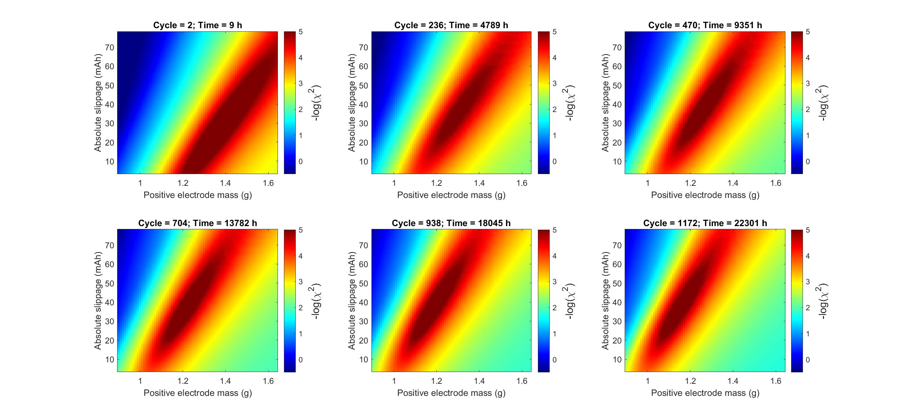
66824, Fixed upper cutoff, 100% DOD C/10, 40°C

Slide 10
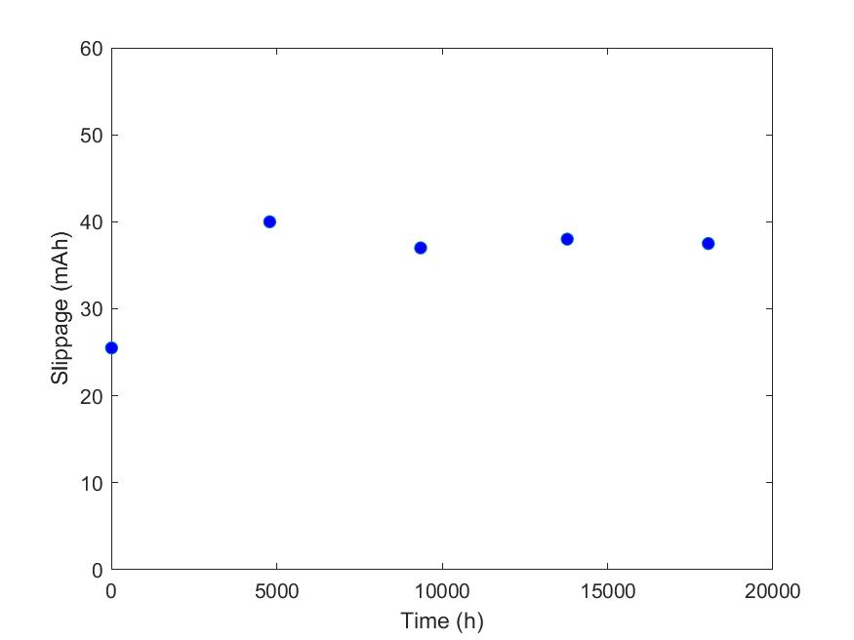
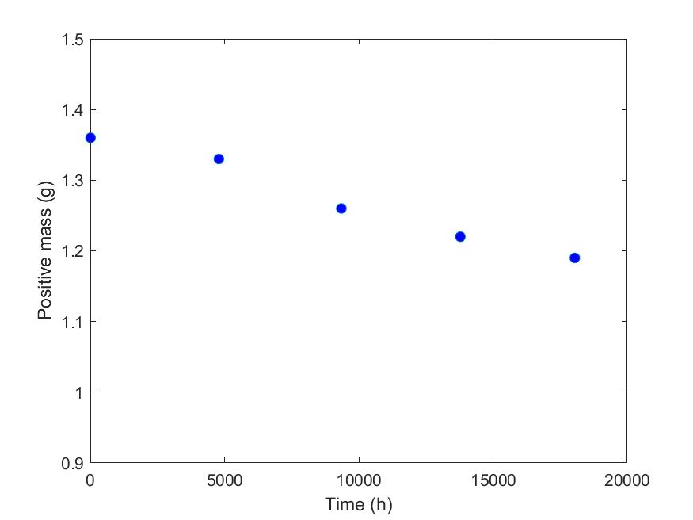
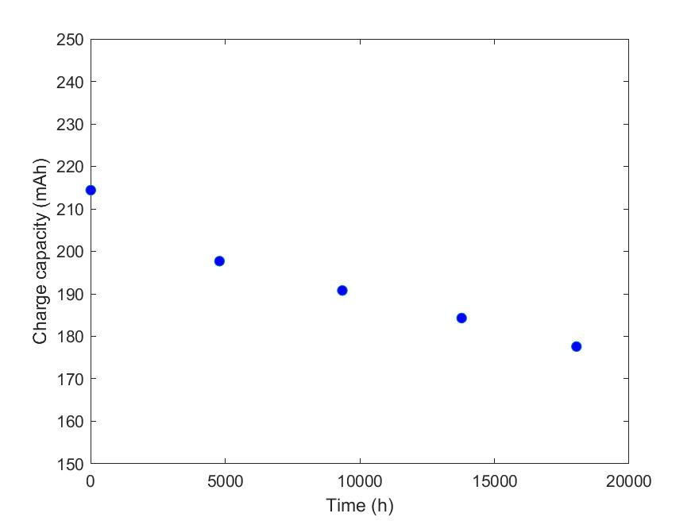
66824, Fixed upper cutoff, 100% DOD C/10 , 40°C

Slide 11
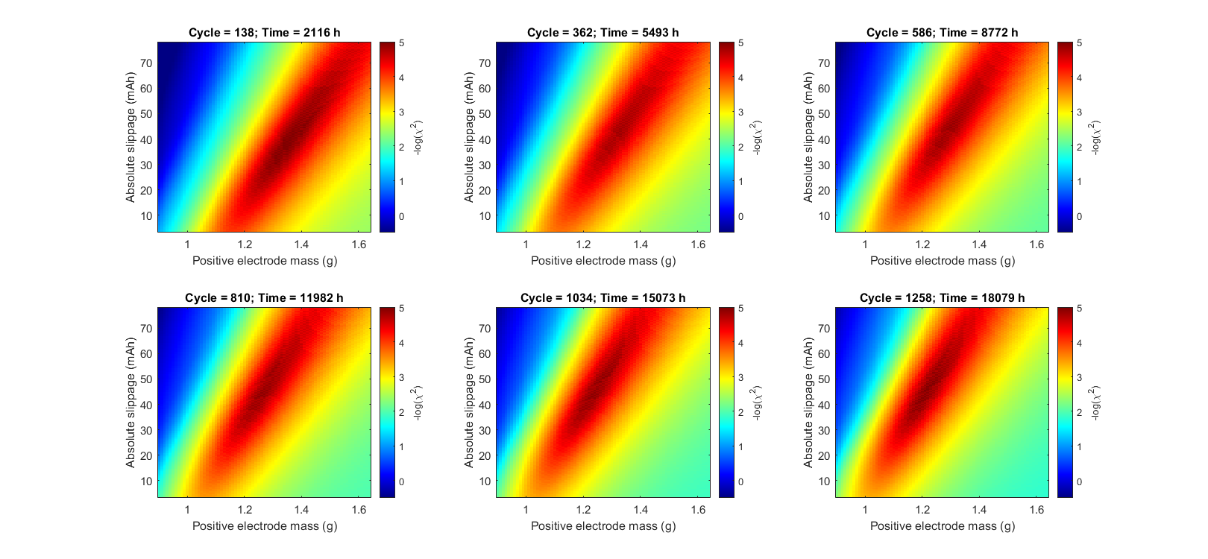
66830, Fixed upper cutoff, 75% DOD C/10 , 40°C

Slide 12
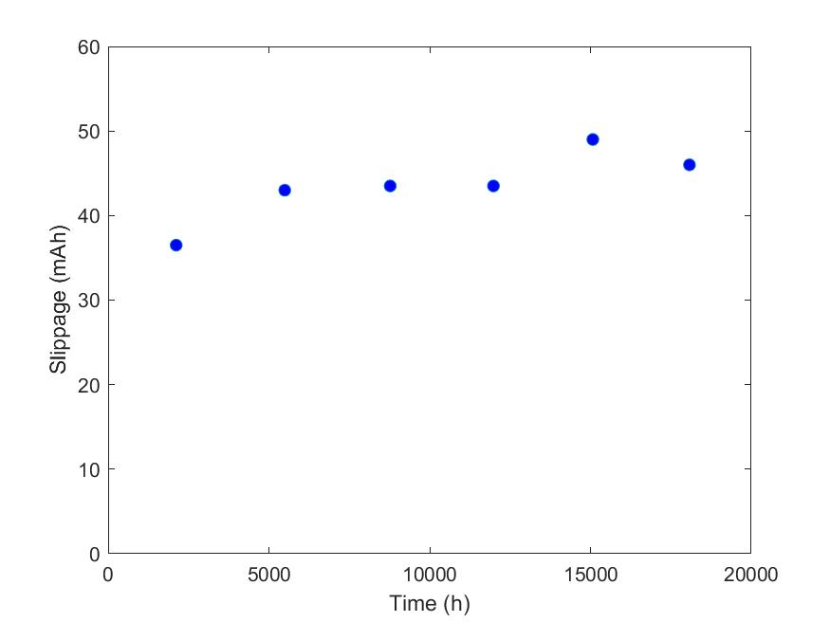
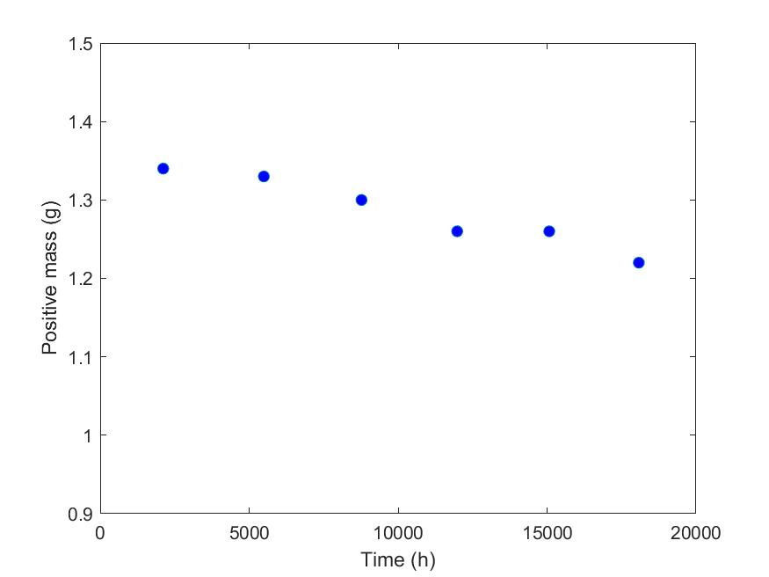
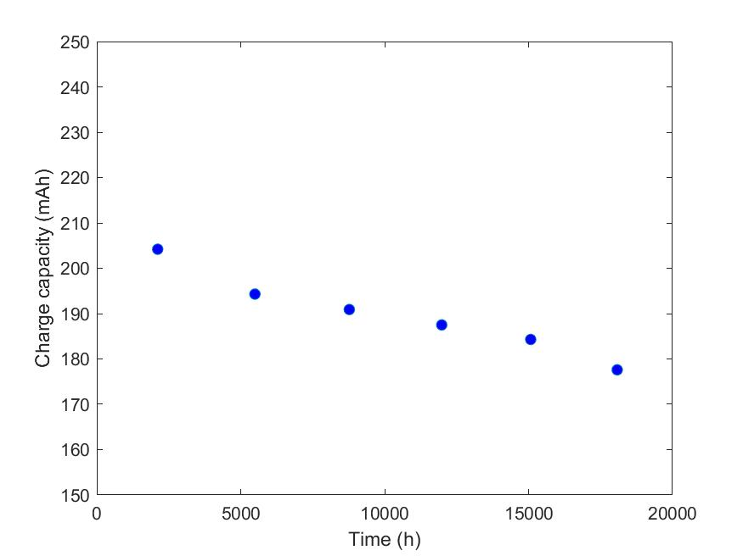
66830, Fixed upper cutoff, 75% DOD C/10 , 40°C

Slide 13
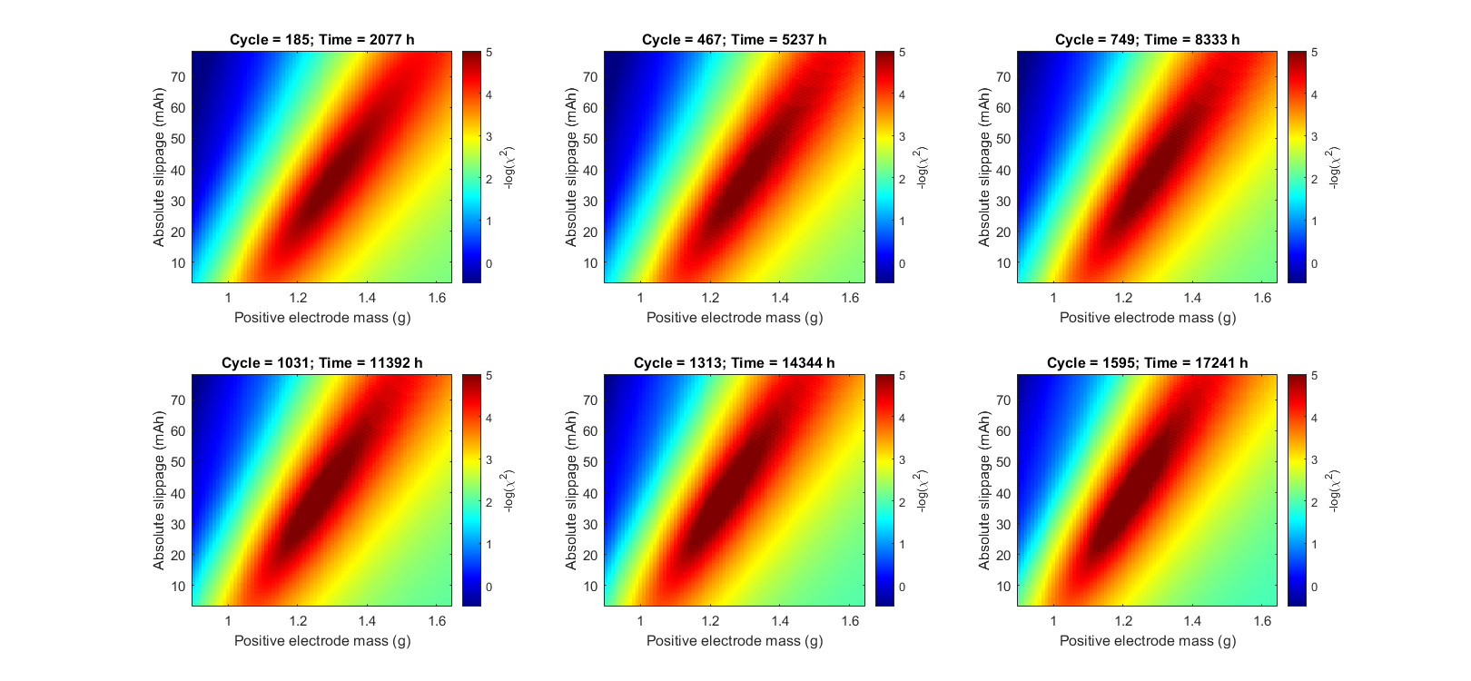
66836, Fixed upper cutoff, 50% DOD C/10 , 40°C

Slide 14
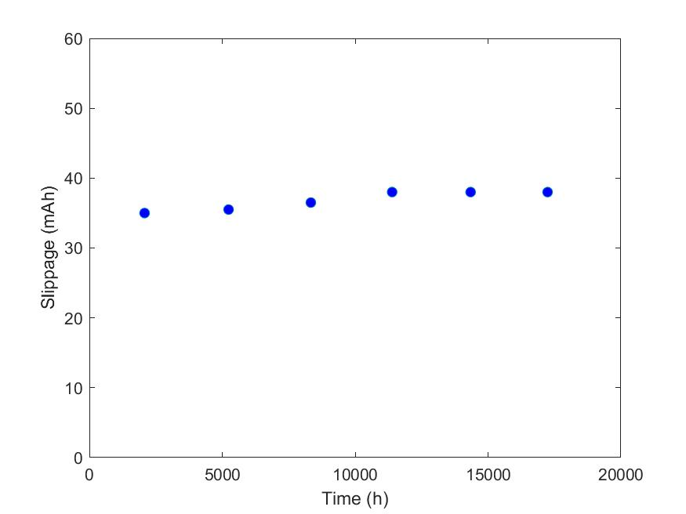
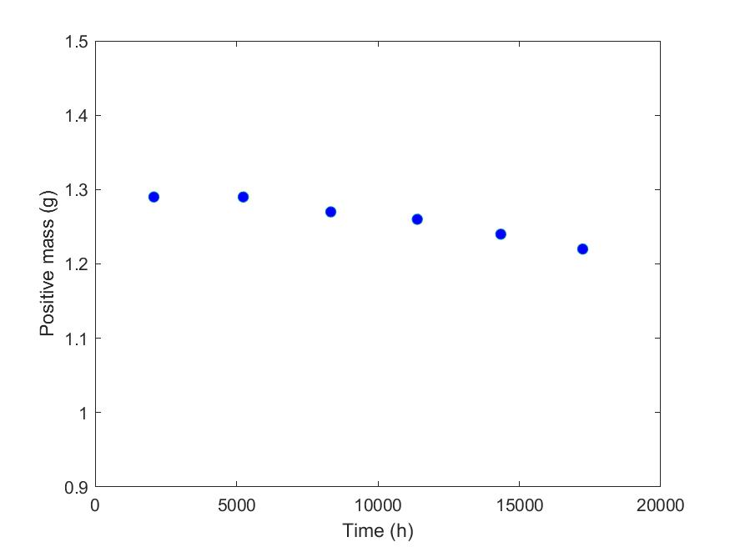
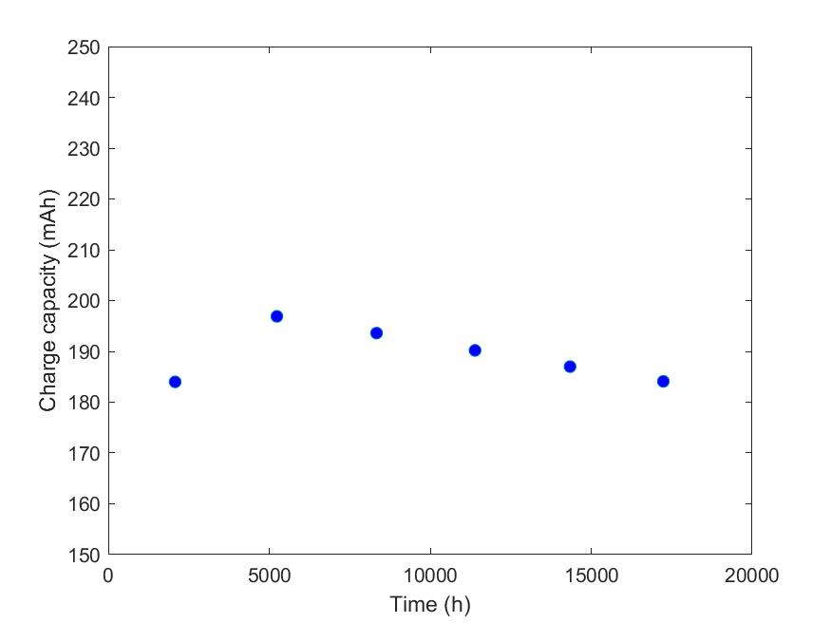
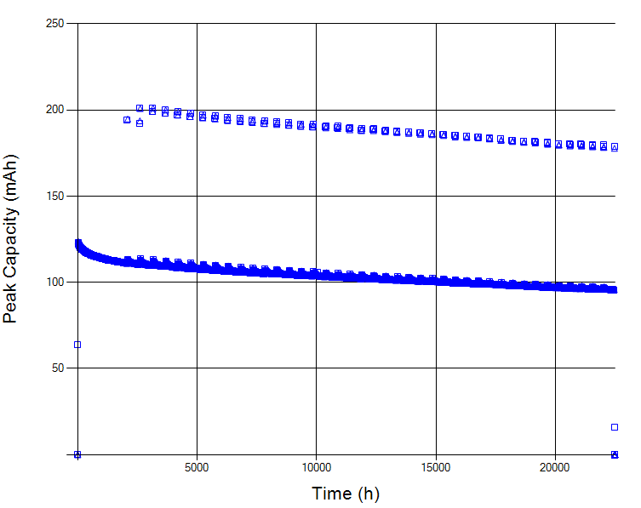
66836, Fixed upper cutoff, 50% DOD C/10 , 40°C

Slide 15
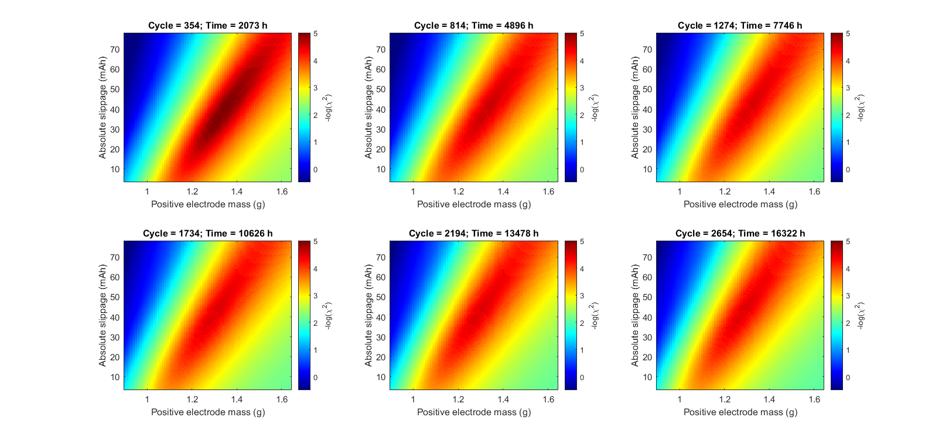
66842, Fixed upper cutoff, 25% DOD C/10 , 40°C

Slide 16
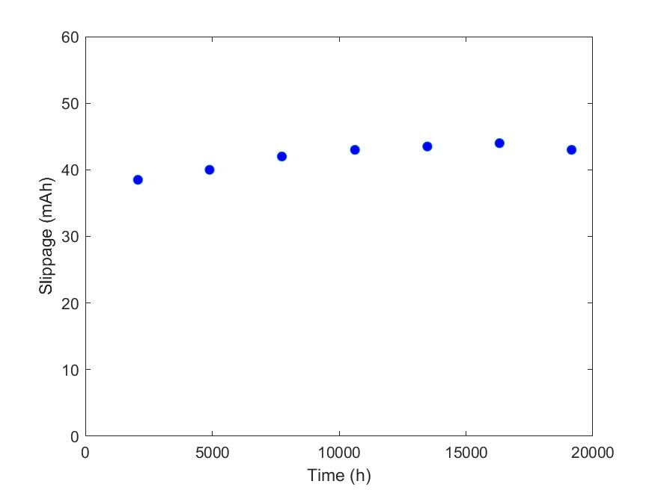
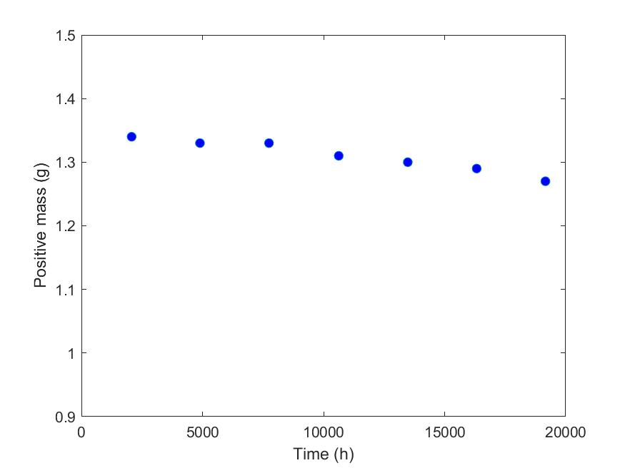
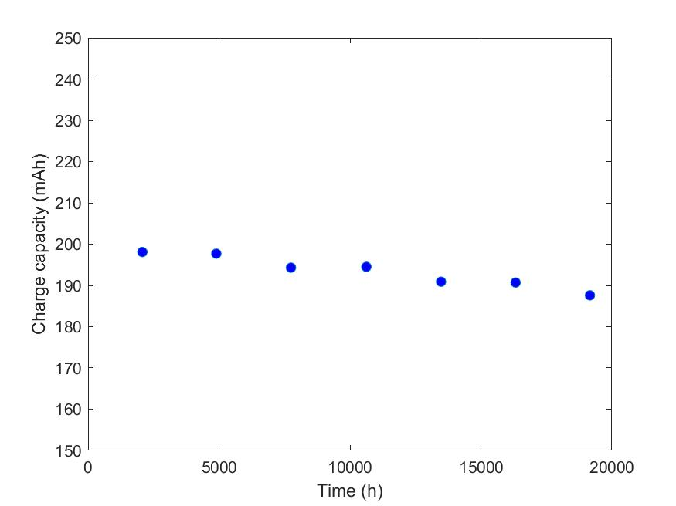
66842, Fixed upper cutoff, 25% DOD C/10 , 40°C

Slide 17
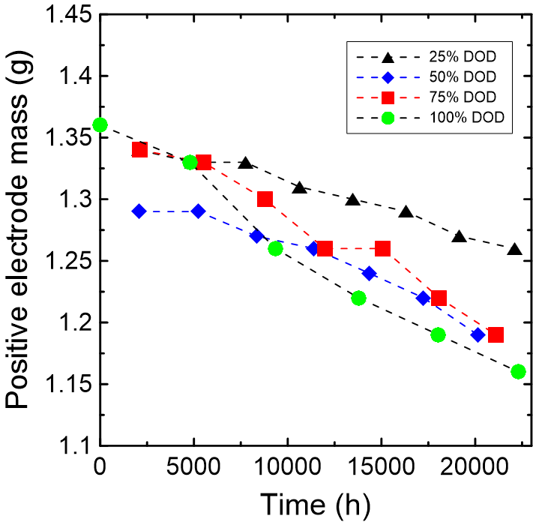
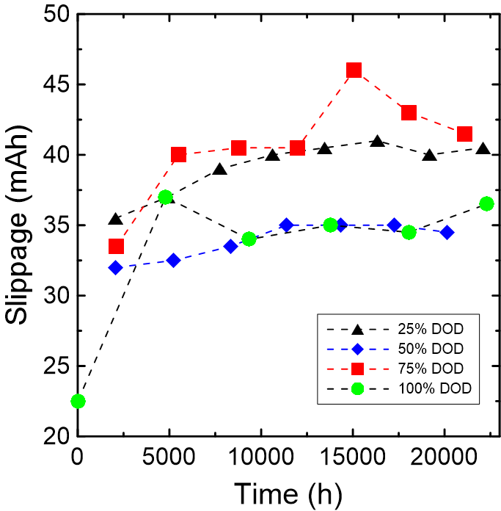
2D matrices: Overall

Slide 18
4D matrices results
Longer waiting time: Around 15 minutes per cell instead of 1 minute, but better Positive electrode mass loss results?
All dV/dQ fits (4D scan) can be found at the end of this PPT.

Slide 19
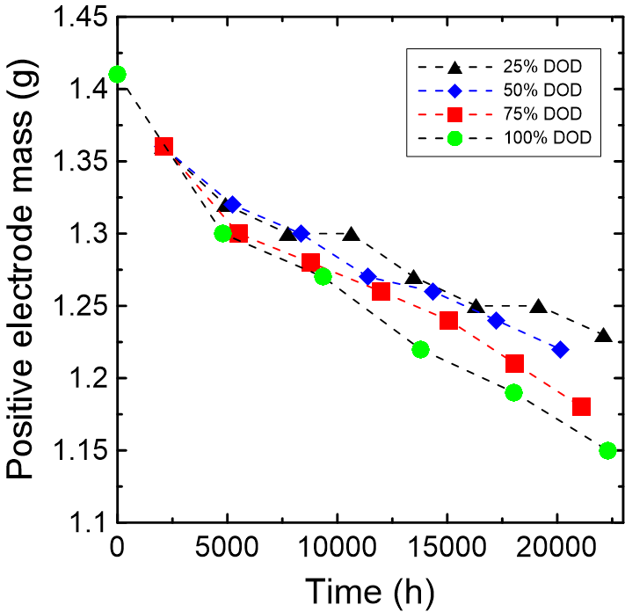
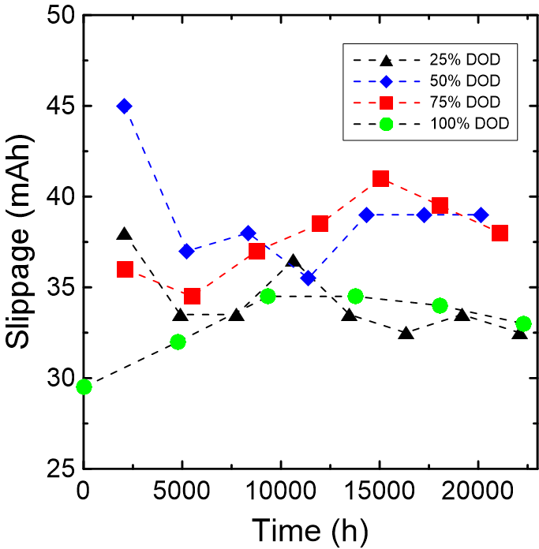
Results for fixed upper cutoff at 40°C and C/10

Slide 20
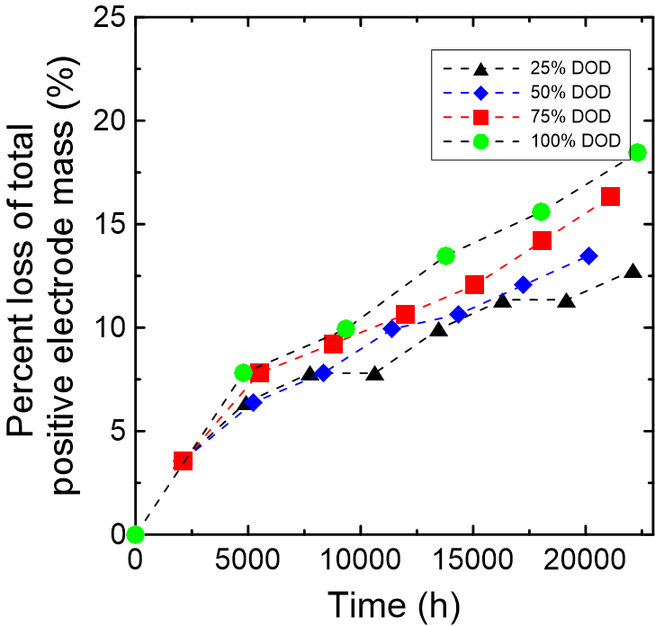
Results for fixed upper cutoff at 40°C and C/10

Slide 21
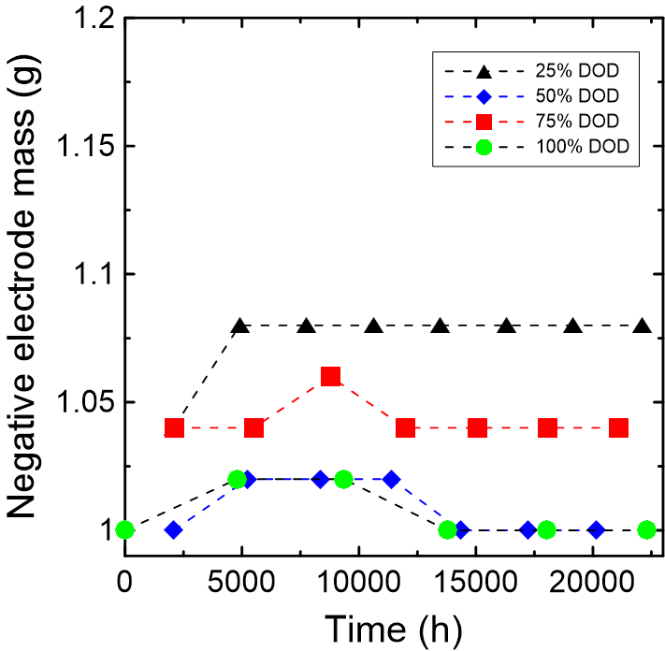
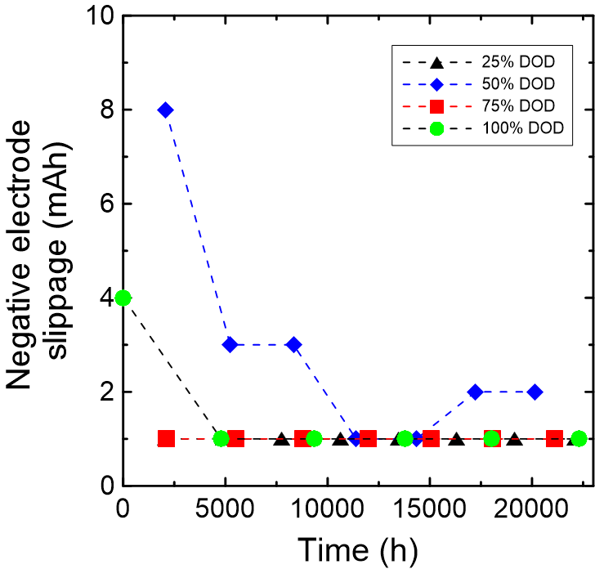
Results for fixed upper cutoff at 40°C and C/10

Slide 22
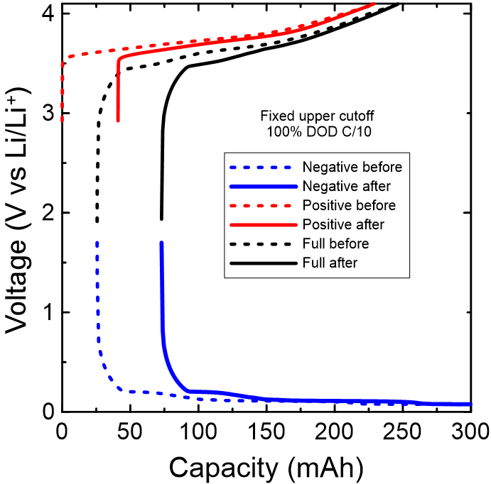

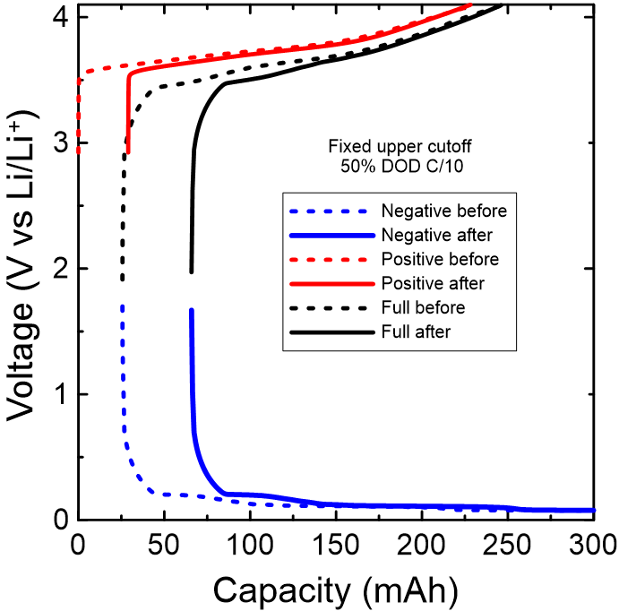
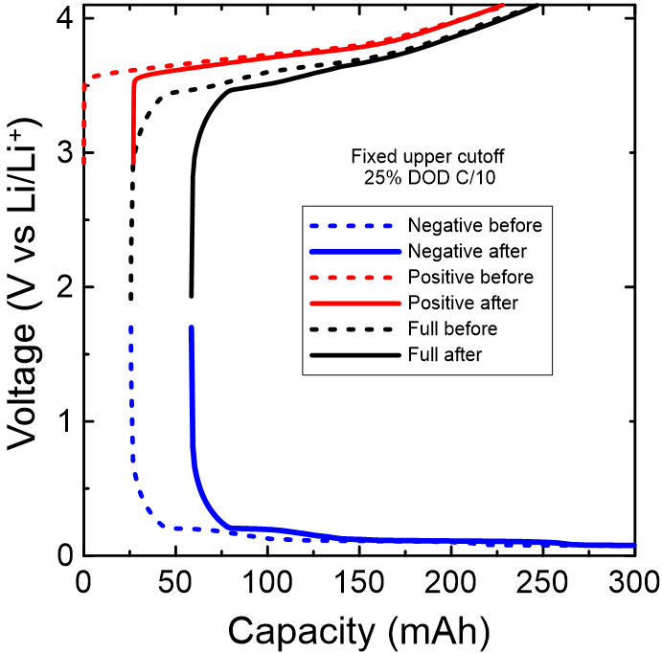
Half-cell analysis (Neware data)
t = 22300 h
t = 21113 h
Numerical summary on the next page
t = 20135 h
t = 22093 h

Slide 23
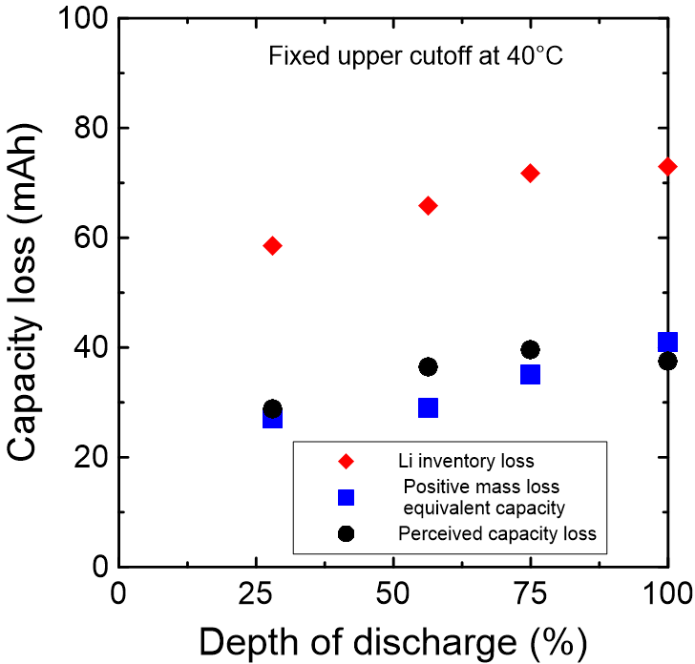
Numerical summary
 | 100% DOD | 75% DOD | 50% DOD | 25% DOD
Positive mass loss equivalent capacity (mAh) | 41 | 35 | 29 | 27
Lithium inventory loss [SEI] (mAh) | 73 | 72 | 66 | 59
Perceived capacity loss (mAh) | 37 | 40 | 36 | 29

Slide 24
Conclusion and Future
Li inventory loss and positive mass loss trends can be seen versus DOD.
Test the program when the current is not constant (C/5, C/3 cells).
Test fixed lowercutoff cells.
Improve confidence that the program work as expected.
Improve tolerance to experimental noise?
Test cells that are not within the DOD matrix (C/10 check up).

Slide 25
Cycling data: Fixed Upper cutoff 40°C (i.e. all 4.1 V)
Additional data

Slide 26
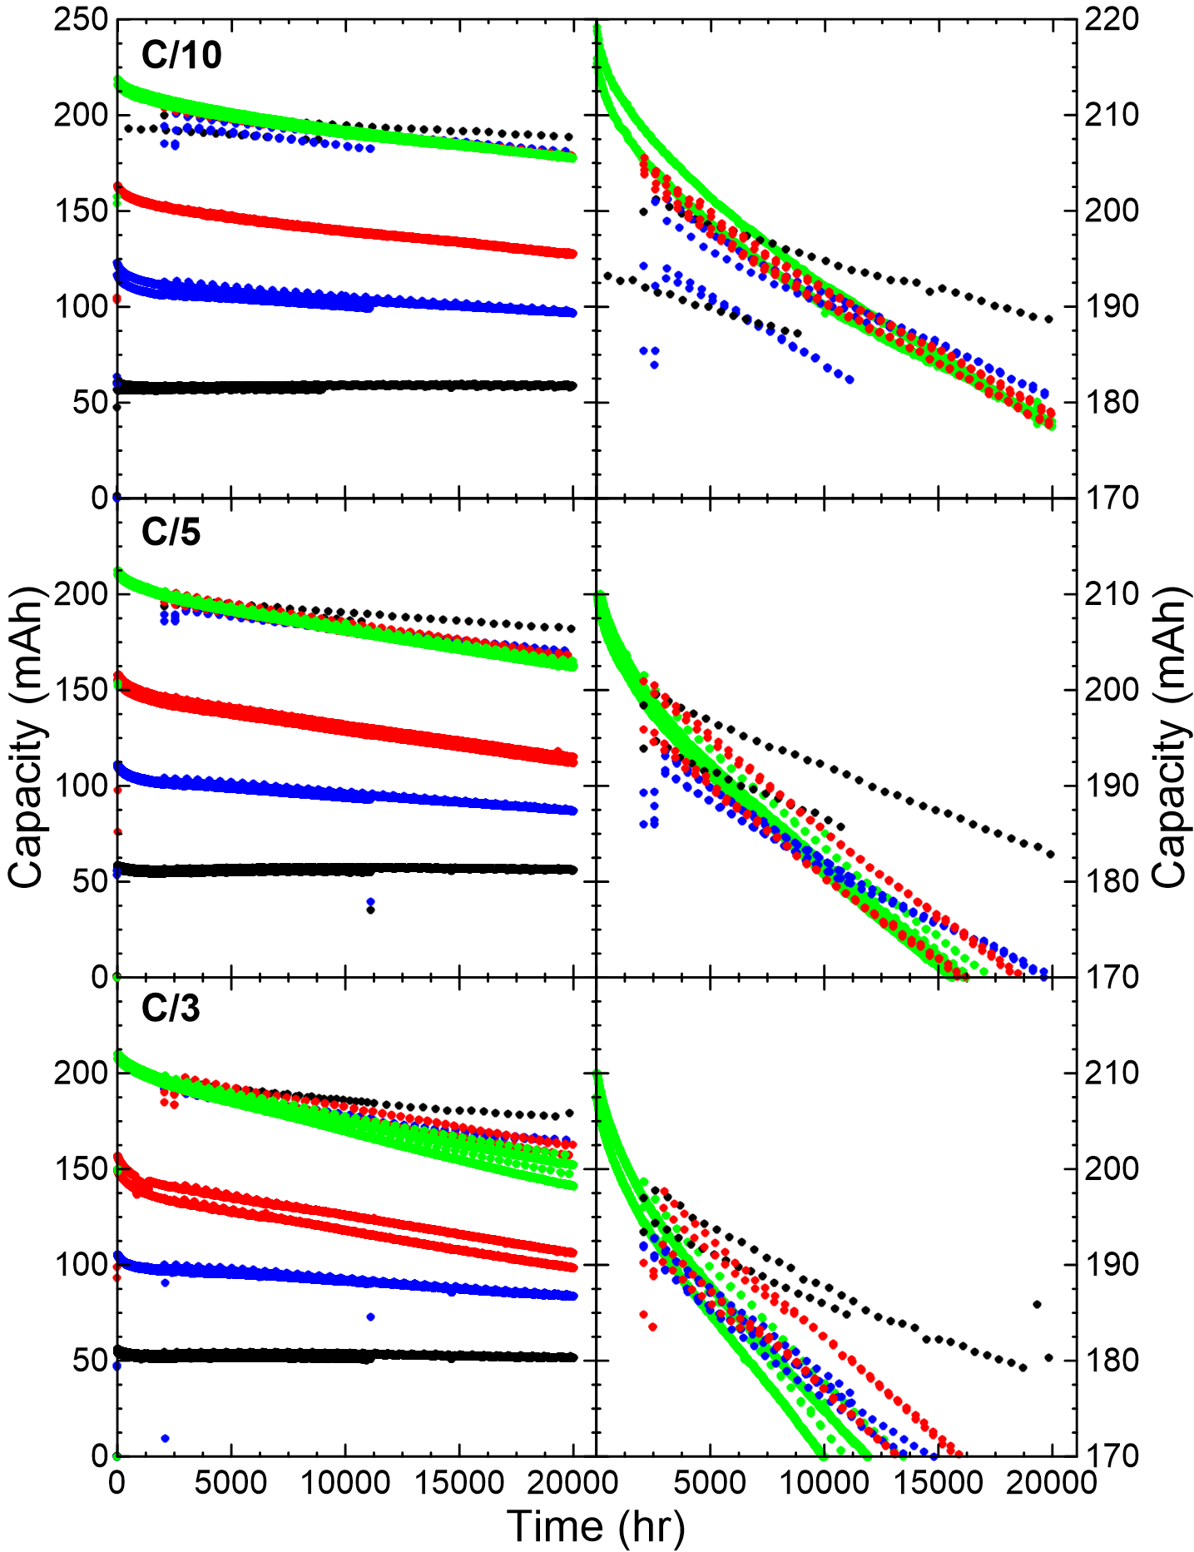
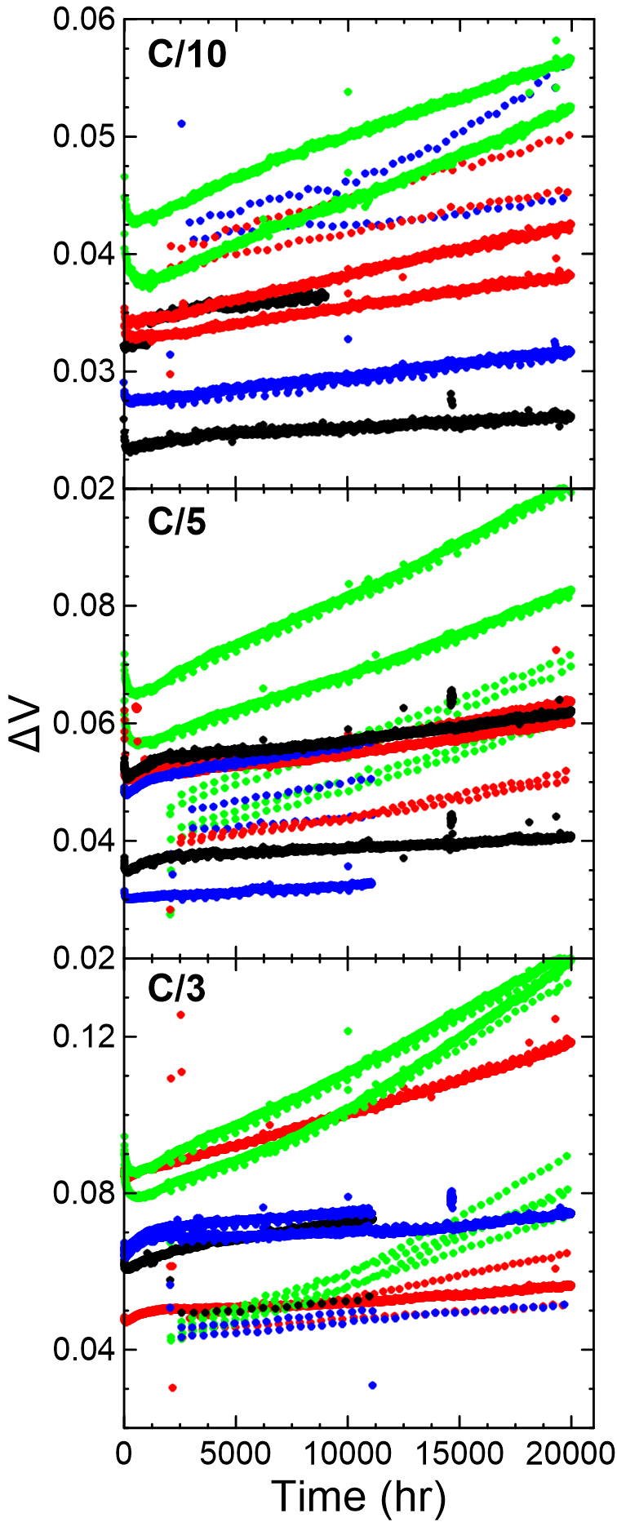
Figure 4
a)
b)
~1170 cycles
~1580 cycles
~2090 cycles
~3610 cycles
c)
d)
e)
~2370 cycles
~3330 cycles
~4470 cycles
~7350 cycles
f)
g)
h)
~4120 cycles
~5960 cycles
~7410 cycles
~12650 cycles
i)

Slide 27
4D matrices: dV/dQ fits Orange: Experimental data Blue: Half-cell data
Additional data

Slide 28
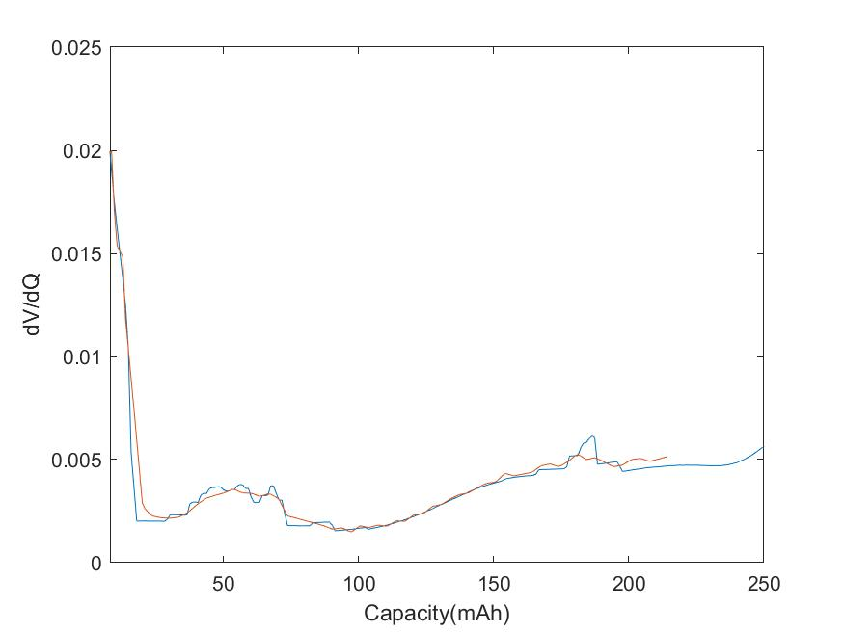
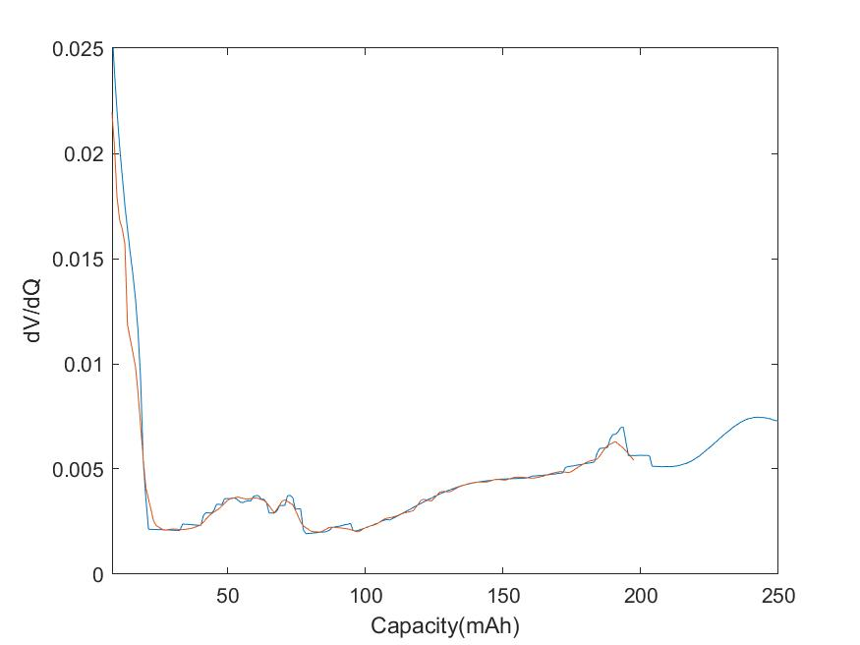
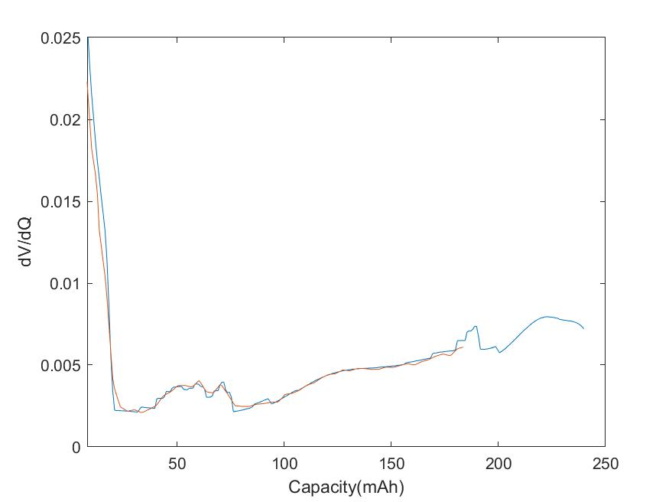
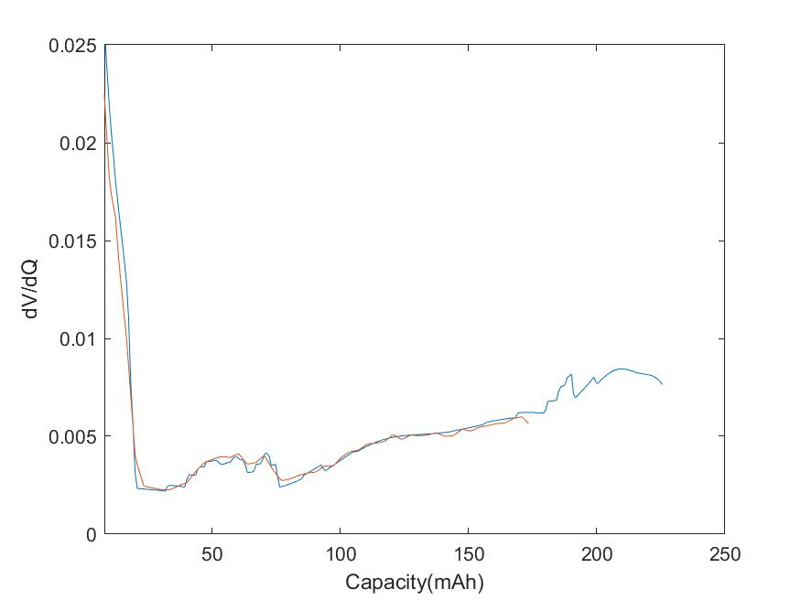
66824 (100% DOD, C/10, fixed upper cutoff at 40°C)
Cycle = 2
Cycle = 236
Cycle = 704
Cycle = 1172

Slide 29
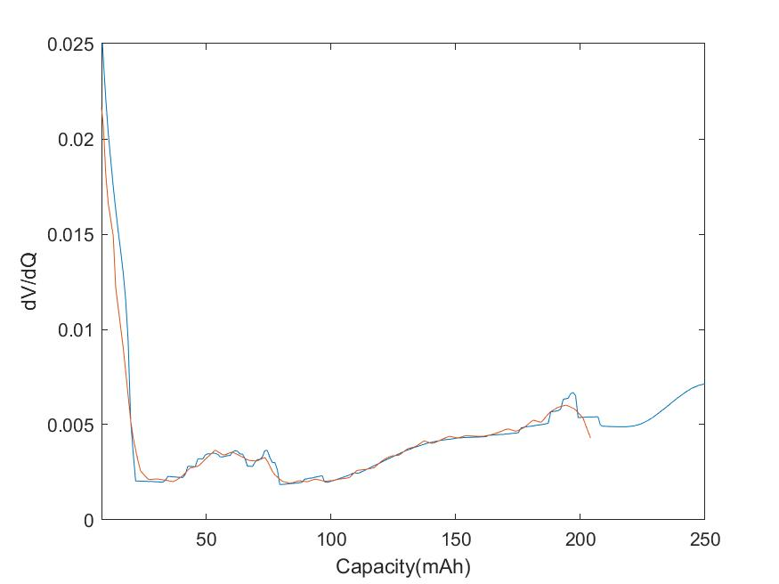
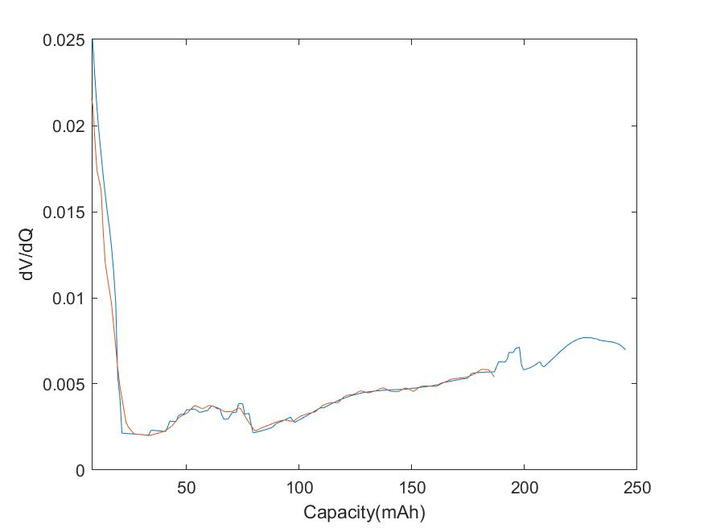
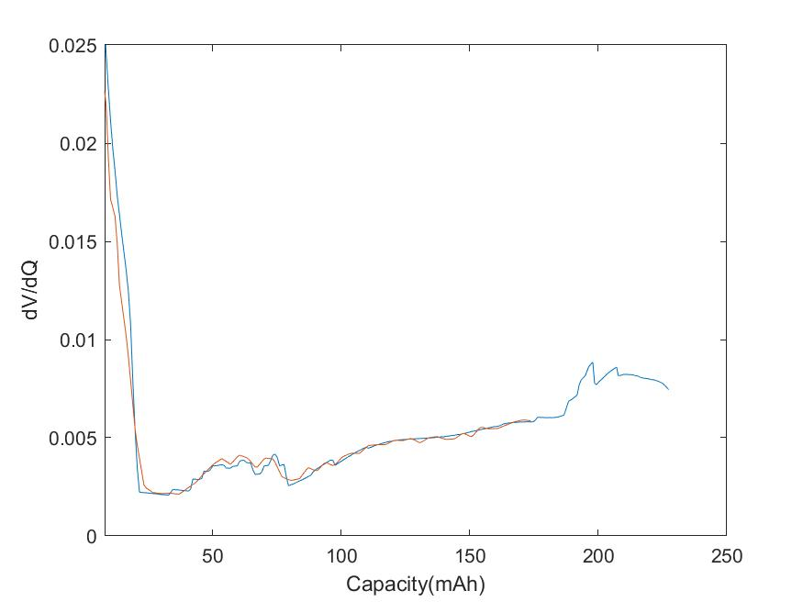
66830 (75% DOD, C/10, fixed upper cutoff at 40°C)
Cycle = 138
Cycle = 810
Cycle = 1482

Slide 30
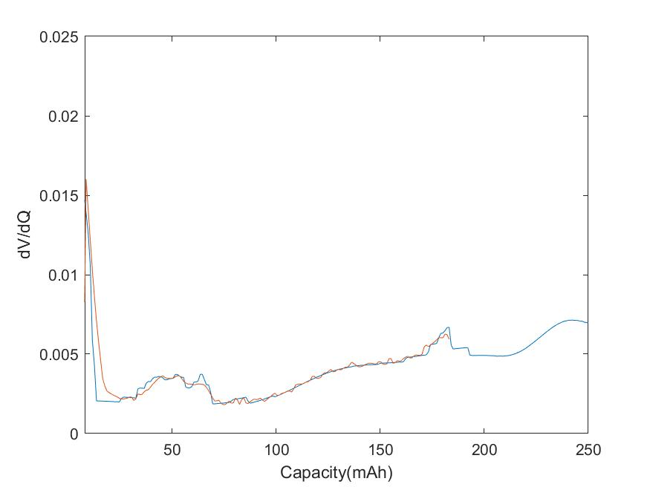
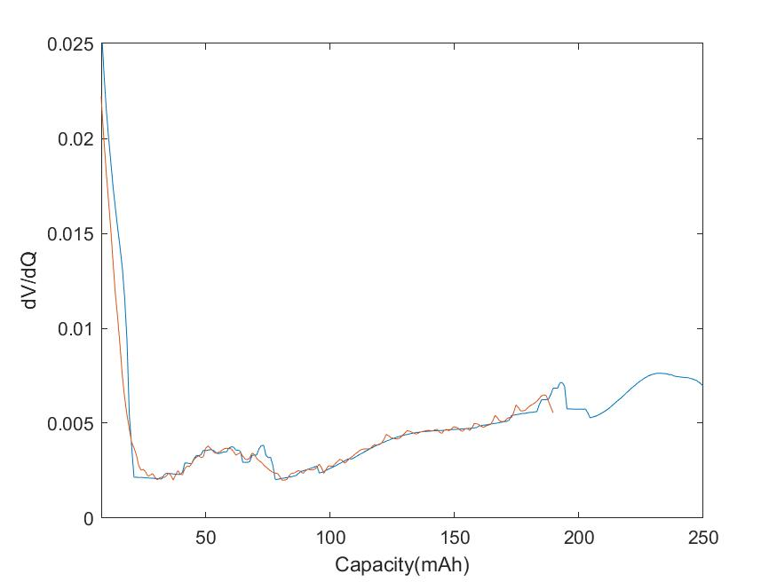
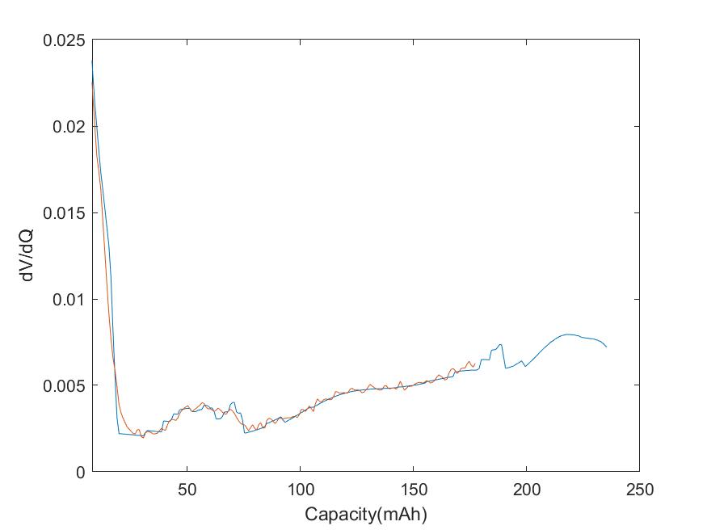
66836 (50% DOD, C/10, fixed upper cutoff at 40°C)
Cycle = 185
Cycle = 1031
Cycle = 1877

Slide 31
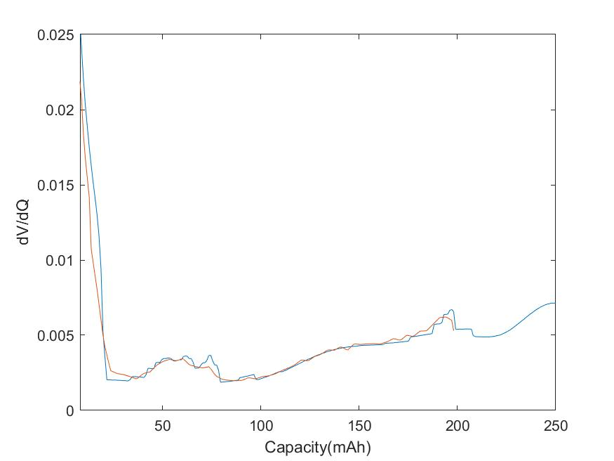
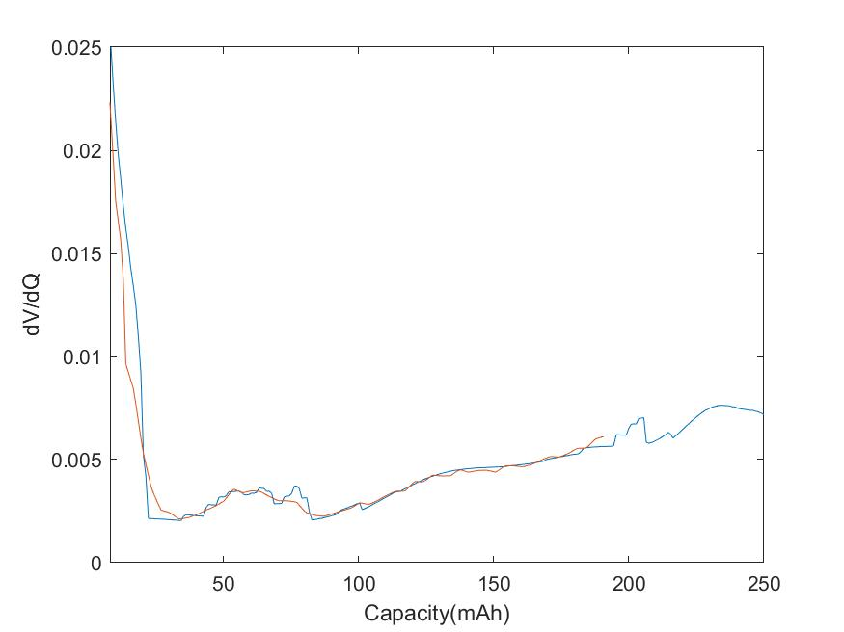
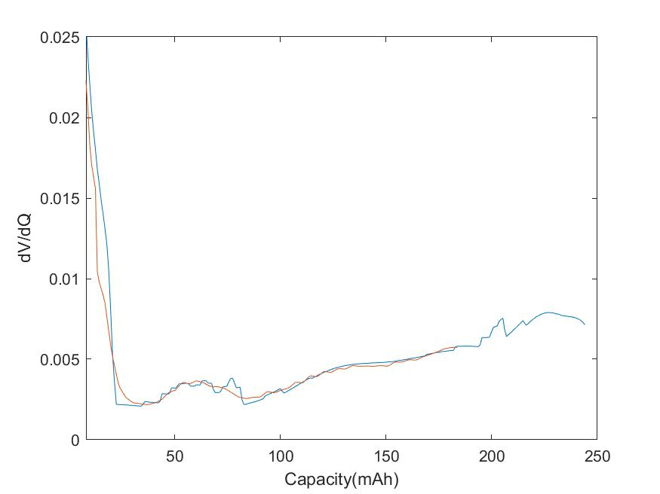
66842 (25% DOD, C/10, fixed upper cutoff at 40°C)
Cycle = 354
Cycle = 2194
Cycle = 3574

